Slide 1


Slide 2
JavaScript
.
Materials by:
Eng Mohamed Oraby
[Review/Refine] Dr Mostafa Saad Ibrahim
© 2026 Cskilled. All rights reserved.
Reproduction or redistribution of this content is prohibited without prior permission.

Slide 3
What Does “Printing” Mean in JavaScript?
In the context of JavaScript, "printing" refers to the various ways you can display or output data, messages, or variable values to the user or for debugging purposes.
unlike traditional printing to a physical printer, JavaScript output usually appears in a web browser, a console, or as a pop-up.
Common Output Destinations:
Browser console (for debugging)
Web page content (for users)
Alert boxes (for notifications)
Browser's standard output (for printing)

Slide 4
Why is it important?
Debugging: Essential for understanding how your code is executing and identifying errors.
User Feedback: Providing information or results to the user.
Monitoring: Observing the state of variables and program flow.

Slide 5
Key Methods We'll Cover
Console.log()
Alert()
Confirm()
Prompt()
Document.write()
innerHTML
innerText

Slide 6
Method Selection Criteria
Purpose: Debugging vs. user display
Context: Development vs. production
User Experience: Intrusive vs. seamless

Slide 7

console.log() - The Debugger's Best Friend
Purpose: The most common and recommended way to output information to the browser's developer console. Primarily used for debugging and inspecting values
Syntax

Slide 8
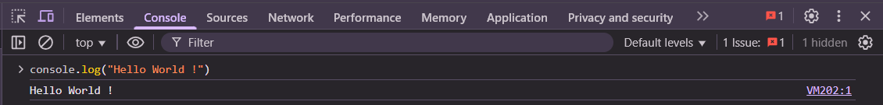
console.log() - The Debugger's Best Friend
To open the Web Console click on f12

Slide 9
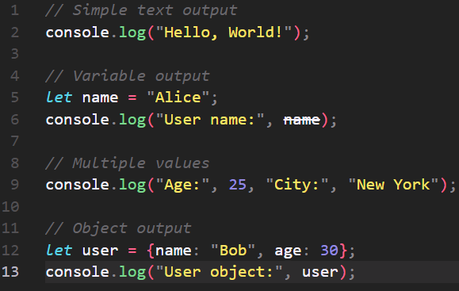
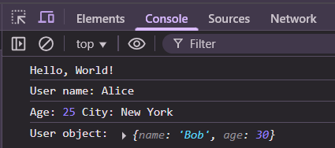
console.log() - The Debugger's Best Friend
Examples

Slide 10
console.log() - The Debugger's Best Friend
Typical Use Cases:
Displaying variable values during development.
Tracing the execution flow of your code.
Inspecting objects and arrays.
Debugging errors.

Slide 11
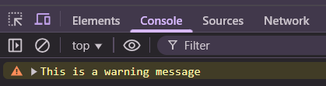
Beyond Console.log() – other console methods
console.warn()
Purpose: Outputs a warning message to the console. Often styled differently (e.g., yellow background) to highlight warnings.

Slide 12
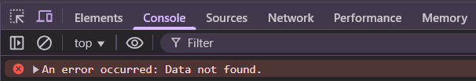
Beyond Console.log() – other console methods
console.error()
Purpose: Outputs an error message to the console. Typically styled with a red background to indicate an error.

Slide 13
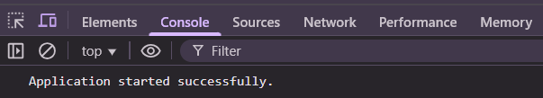
Beyond Console.log() – other console methods
console.info()
Purpose: Outputs an informational message to the console. Similar to log(), but can be styled differently by some browsers.
.

Slide 14
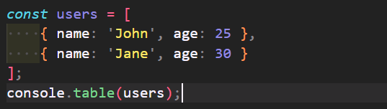
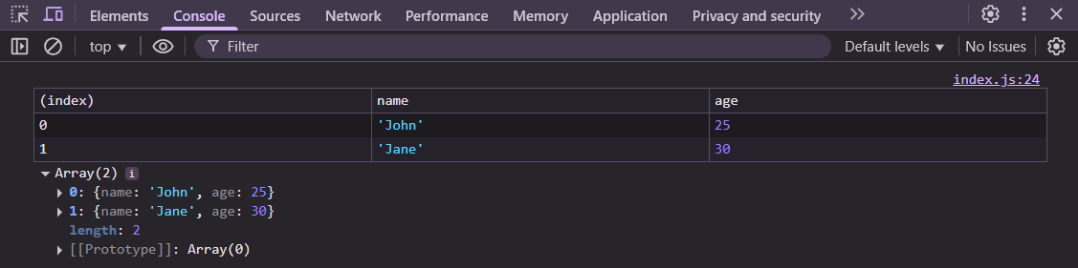
Beyond Console.log() – other console methods
console.table()
Purpose: Displays tabular data in the console. Very useful for arrays of objects or objects with consistent properties.
.

Slide 15
Your Turn
Instructions: Open your browser's developer console (usually by pressing F12 or Right-Click -> Inspect -> Console tab).
Print your name and age in the same line
print error with Hello World Message

Slide 16
“Acquire knowledge and impart it to the people.”
“Seek knowledge from the Cradle to the Grave.”
Notes:
That is all!

